Slide 1
Behavior Driven Development (BDD)
Closing the Loop on a Great Fiori UX
UX130
John Patterson | @jasper_07

Slide 2

There has never been a better time to be a developer
Notes:
Everyone wants to be a developer, including C Level executives
Last night lots of tech – digitial transformation
Not just a system transformation but also a cultural transformation
Agile Transformation -> reduce the cycle time for delivering software, from ideation to realization as quick as possible

Slide 3
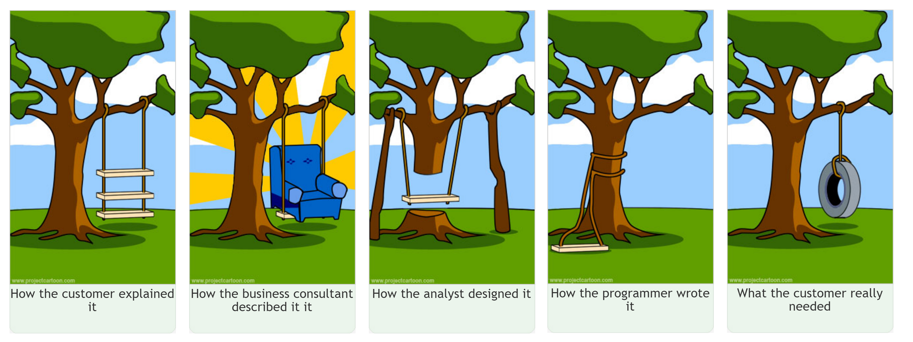
What the customer really needed
Notes:
Chinese whispers, everyone interprets the requirement differently

Slide 4
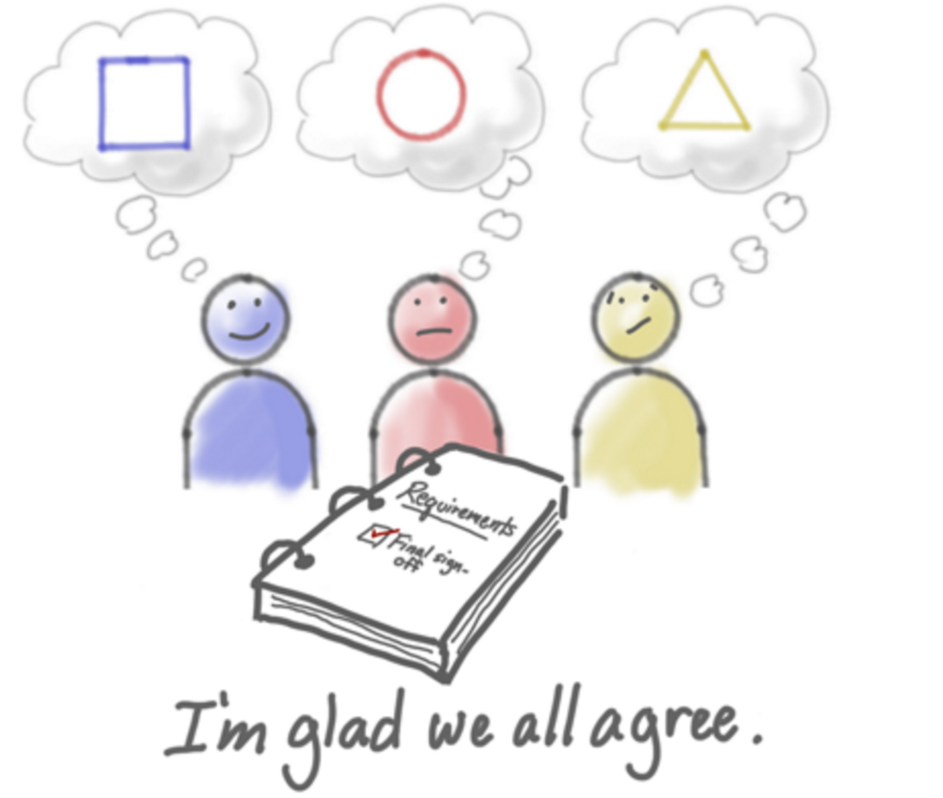
http://www.agileproductdesign.com (Jeff Patton)
Notes:
The problem

Slide 5
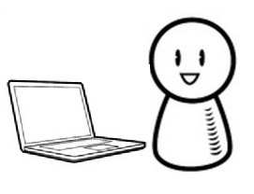

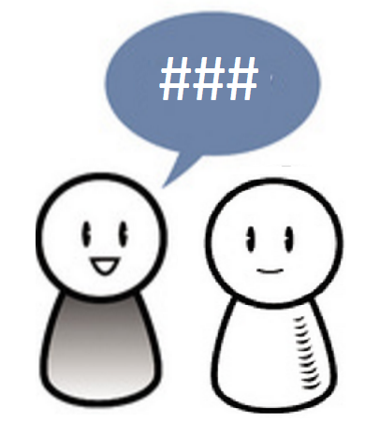
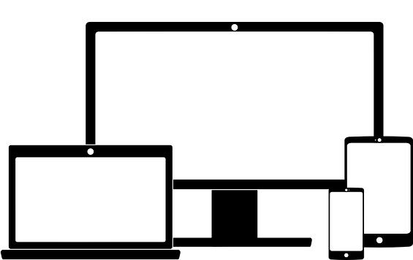


Traditional Development Process
The developer translates the requirements into software
The analyst writes a requirements document
The user tells the analyst what he wants
The tester translates the requirements into test cases
Notes:
Lots of room for ambiguity, room for misunderstanding and missed requirements
The tester finds lots of bugs, the user doesn’t get what they wanted
Cycle times of many months

Slide 6
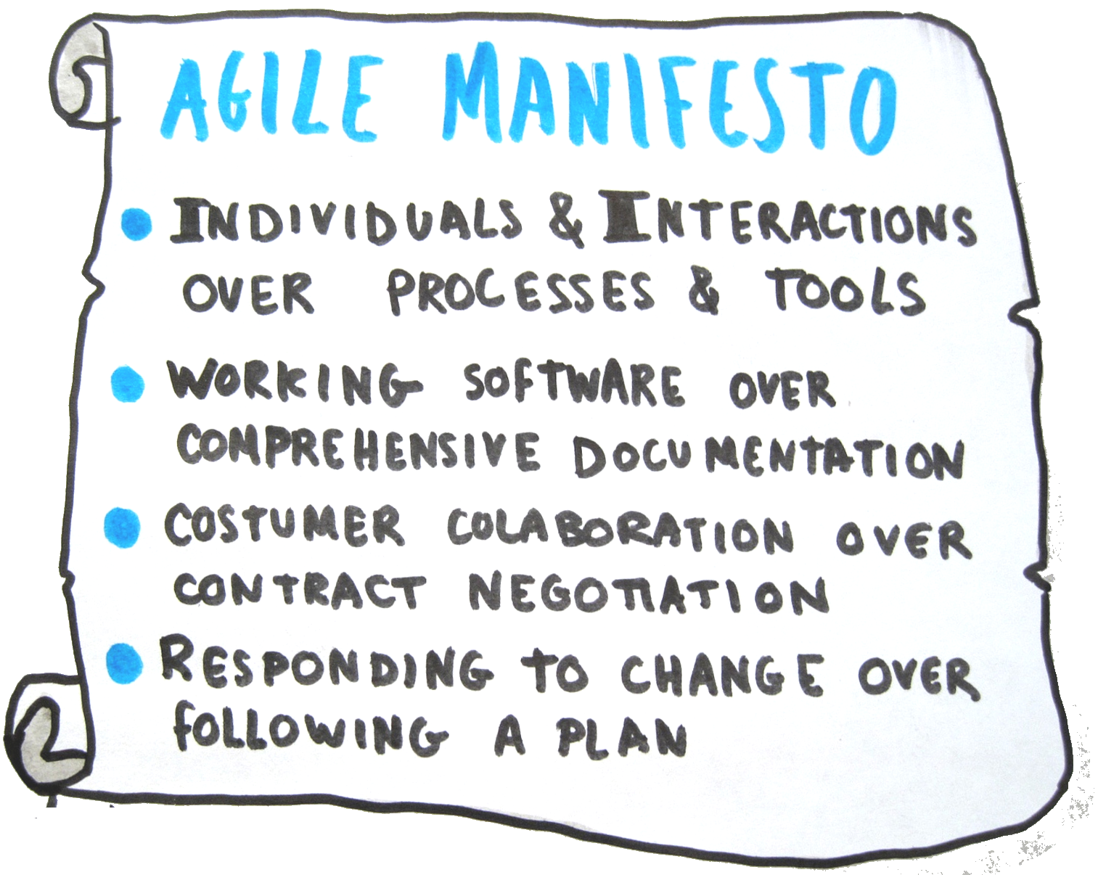
Notes:
2001 17 software visionaries got together in a ski resort to discuss why so many projects were failing
The result was a the “agile manifesto” they came up with 4 key values

Slide 7

The 7 Wastes In Software Development
Defects
Extra Features
Handoffs
Partially Completed Work
Task Switching
Delays
Un Needed Processes
Notes:
Lean software development, has its roots in the lean manufacturing, 1948 Toyota Production System was born and this became the basis for Lean Manufaturing
Toyota had a problem, times were tough and they had little money,
The could only build the cars that people were ordering, to be competitive that meant they had to decrease the cycle time it took to build a car
Fast as possible reducing wastes, software engineering has followed this

Slide 8
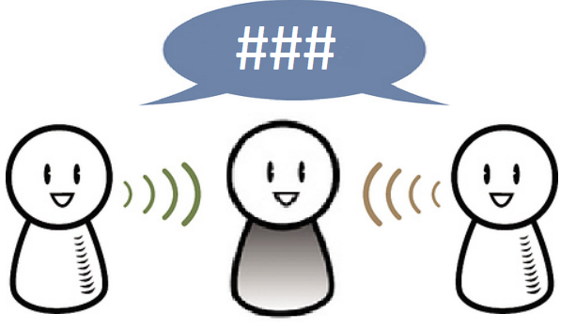
User Stories
What are we trying to build?
Notes:
User stories have many purposes
They describe a users needs or a feature of a system
They form part of the product description
They are used for planning and estimation
A token for a conversation, a conversation that has to happen at some point in time

Slide 9
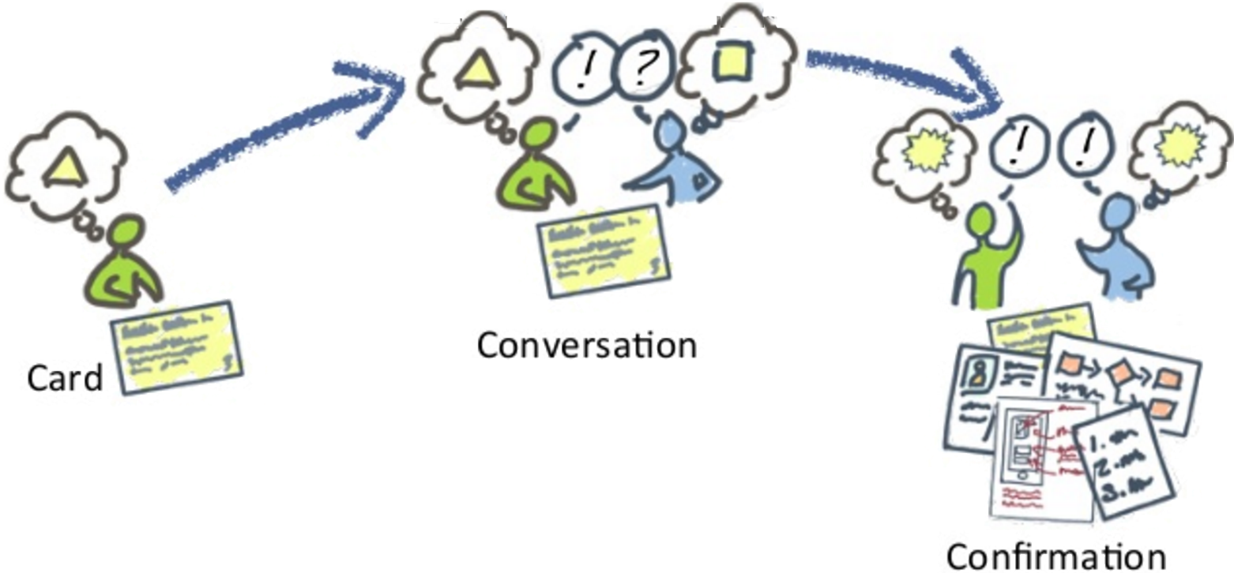
Story Lifecycle
http://www.agileproductdesign.com (Jeff Patton)
Notes:
Card conversation confirmation is a mantra used in agile

Slide 10
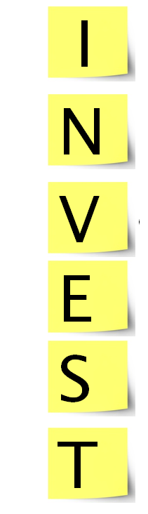
Follow the INVEST guidelines for good user stories
ndependent
egotiable
aluable
stimatable
mall
estable

Slide 11


As an unregistered user
I want to be able to enter my contact details
So that I can create an account
As a developer
I want to go to
SAP Teched
So that I can learn cool stuff
User Story Template
As a [user role]
I want [feature]
So that [benefit]
User Story Template
As a [user role]
I want [feature]
So that [benefit]
As a purchaser
I want to create a wish list of books
So that I can return and purchase later
As a user with a reservation
I want to cancel my reservation
So that I can get a refund
Notes:
A template for having the right conversation
Business readable, ubiquitous language

Slide 12
As a customer
I want to withdraw cash from the ATM
So that I don’t have to wait in line at the bank
Acceptance Criteria
Scenario
Given [initial condition]
When [event(s) occur]
Then [expected outcome]
Scenario: Account is overdrawn
Given account is overdrawn
And the card is valid
When the customer requests cash
Then ensure a rejection message is displayed
Scenario: Account is in credit
Given account is in debit
And the card is valid
When the customer requests cash
Then ensure cash is dispensed
And account is debited
Notes:
The user story is a high level description of a feature, to drive out the requirements and define the boundariacceptance criteria is used to describe the conditions
Written in plain English, like a user story any one should be able to read the accpetanc criteria and understand what it’s doing
Scenarios drive the requriments of the feature
GWT is a clearly defined structure that can be

Slide 13

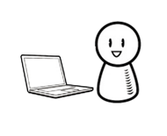
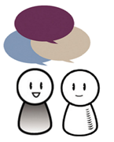
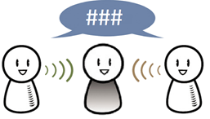


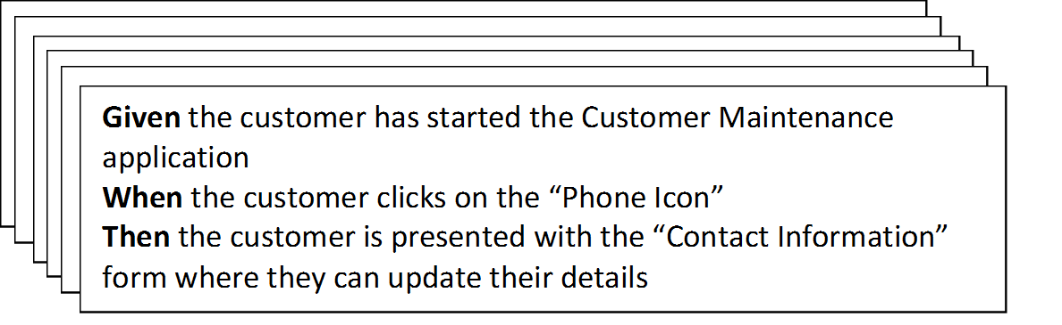
BDD Development Process
The scenarios guide the developer and act as automated tests
The analyst, developer and tester elaborate the requirements together
The user gives feedback early and often
The product owner and users have a conversation with the analyst about what they need
They define the requirements as structured scenarios
The tester uses these scenarios as the basis for their tests

Slide 14
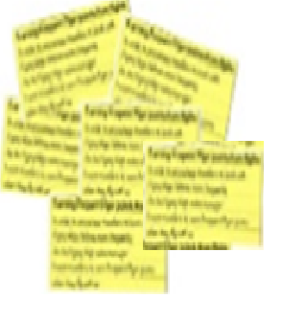
The Three Amigos
Shared Understanding
Analyst
Conversations
Tester
Developer
Automatable
Acceptance
Criteria
Notes:
Analyst or business owner
Get together and talk through the story, talk through the different examples, try to jutify why the story Is needed
Are there alternative ways we can deliver this, can we do it faster
Describe the requirements in the form of acceptance criteria
Don’t leave the the three amigos session until you have acceptance criteria you can automate
Concrete tangible acceptance criteria, these acceptance
Concrete example

Slide 15
So what is BDD?
Building the right software
Hunting out value
Automated Acceptance Criteria
BDD
Collaboration
API and code design
Living Documentation
Building the software right
Notes:
Collaboration technique
What features add value, half the lines of code in production are never used, it about finding the
Identifying the features that
Automation can help speed up the feedback cycle and the time it takes to push code to production
API and code design – using
Living documentation anyone can read the user stories and acceptance criteria and understand what is being built

Slide 16
Why Automate Tests?
Test
Automation
Reliable
Repeatable
Programmable
Fast
Cost Reduction
Better Quality
Notes:
I hear lots of reason why we shouldn’t write tests

Slide 17
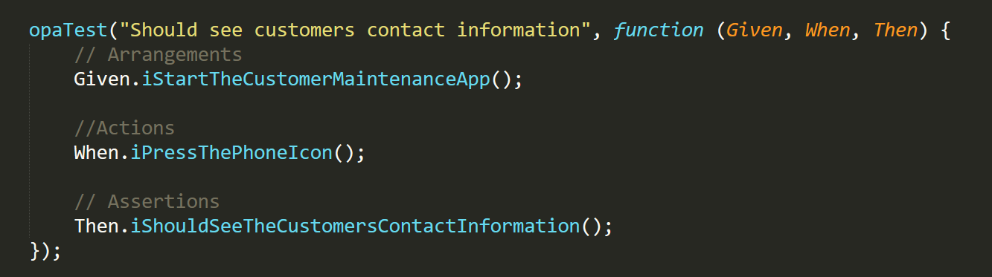
Scenario: Should see customers contact information
Given I start the Customer Maintenance App
When I press the Phone Icon
Then I should see the customers contact information
As a customer
I want to have the ability to update my contact information
So that I can stay informed about when my car needs a service
Notes:
Hopefully everyone knows what OpaTests are

Slide 18
SAPUI5 BDD Example

Slide 19
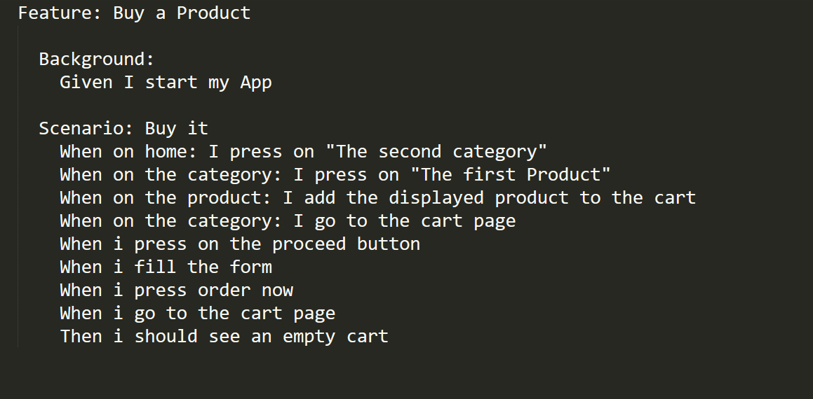
Gherkin Tests in SAPUI5
Notes:
Gherkin is a language that helps you write software’s behavior without detailing how the software is implemented
This actually means that you can write you can write the softwares behavior completely agnostic of how it will be developed
Goto website

Slide 20
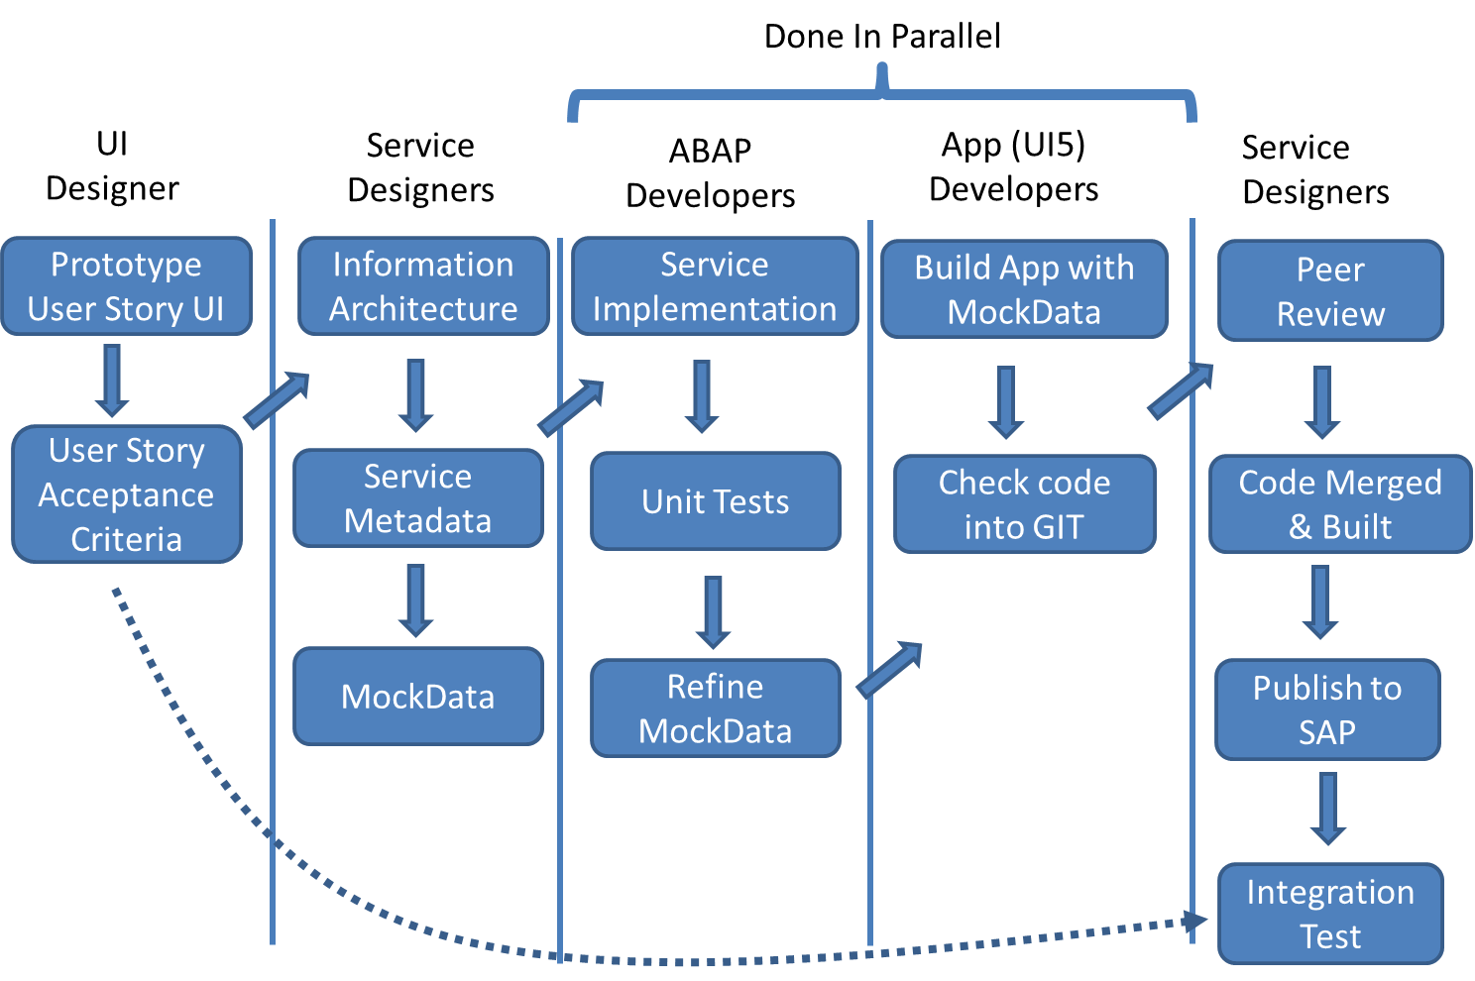
Closing the Loop

Slide 21
“There is nothing quite so useless, as doing with great efficiency, something that should not be done at all.” - Peter Drucker

Slide 22
Take aways
Collaboration is everything
Use a common language to define requirements
Automate tests to provide fast feedback

Slide 23
FEEDback
Please complete a session evaluation for this session!
UX130
John Patterson | @jasper_07
Notes:
.

